Slide 1
VOICE CONTROLLED WHEEL CHAIR
GROUP NO: 03
ECD 334 MINI PROJECT – BTECH.S6 ECE A
GUIDED BY
Prof. RAMANAND A C
PRESENTED BY
9. ANN MARY ROY- KNR21EC016
10. ANURAG R NARAYANAN - KNR21EC017
11. ANUVINDA SATHYAN- KNR21EC018
12. ARATHI S NAIR- PKD21EC017
---------------------------------------------------------------------------------------
DEPARTMENT OF ELECTRONICS AND COMMUNICATION ENGINEERING
GOVERNMENT COLLEGE OF ENGINEERING KANNUR

Slide 2
OBJECTIVES
The project aims in designing a wheelchair that can be operated using Android mobile phone. Android smart phone is used as a remote control for operating the wheelchair.
A mobility aid that allows individuals with limited physical abilities to control the movement of a wheelchair using voice commands.
The wheelchair is equipped with a speech recognition system that interprets spoken words or phrases, translating them into specific actions like moving forward, turning, or stopping.
Overall, it promotes accessibility and autonomy for individuals with mobility challenges.

Slide 3
LITERATURE SURVEY
Sl. No | Title | Authors | Publication & Year | Inference
1. | “Design and Implementation of an Electric Wheel-Chair to Economies it with Respect to Bangladesh” | Humaira Salmin, Hafiz Rakibul, Pratik Kumar Kundu, B.M. Fahmid Jahur Shuvo, K.B.M. Nasiruzzaman and Rahman MD Moshiour, | International Journal of Multidisciplinary Sciences and Engineering, Vol. 5, No. 2, pp: (17-22), February 2014 | Warning system that analyses real situation such as heart rate ,temperature etc. Also a robotic hand to help the patient
2. | “Voice Controlled Motorized Wheelchair with Real Time Location Monitoring” | Nikunj Janak Gor, Amrutha Jeyakumar | International Conference on Energy, Communication, Data Analytics and Soft Computing 2017 | Facility of wireless communication

Slide 4
3. | “Voice Controlled Automatic Wheelchair” | Sumet Umchid, Pitchaya Limhaprasert | The 2018 Biomedical Engineering International Conference | Relationship between user voice command, electrical actuator and motors
4. | “Wheelchair for Physically and Mentally Disabled Persons” | Nirmal T M | International Journal of Electrical and Electronics Research, ISSN 2348-6988 (online), Vol. 2, Issue 2, pp: (112-118), April - June 2014 | High costing of electric wheelchair and modifying the present electric wheelchairs to make it affordable to common people.

Slide 5
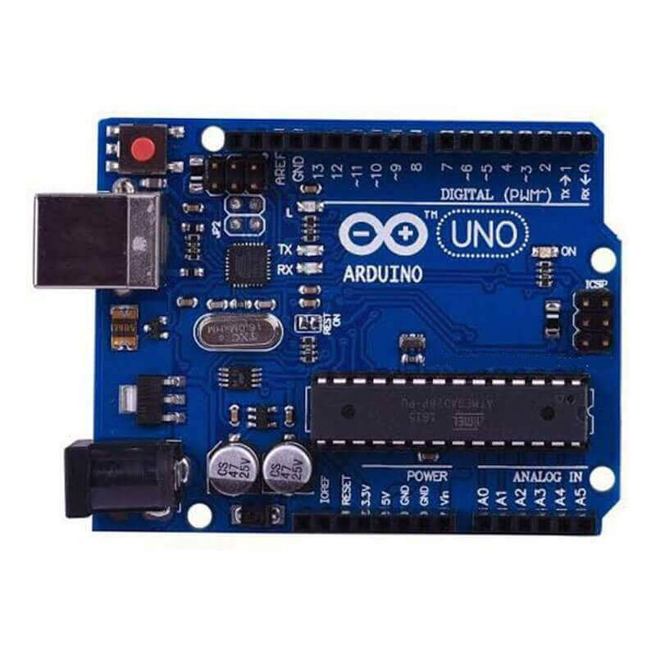
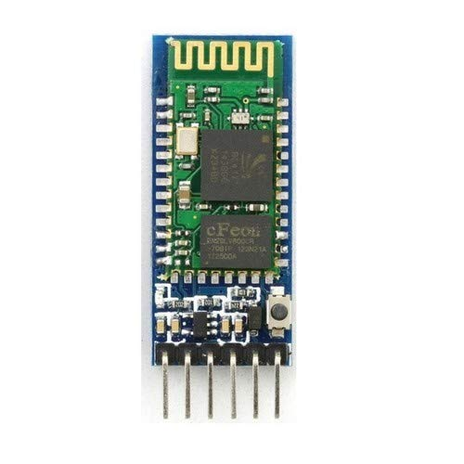
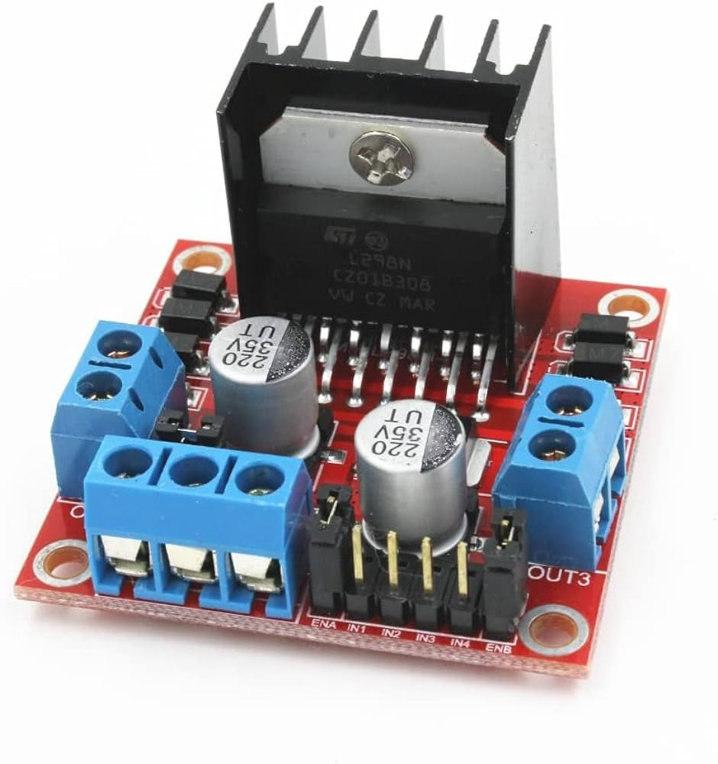
COMPONENTS
Arduino UNO
Bluetooth Module HC-05
L298N Motor Driver

Slide 6
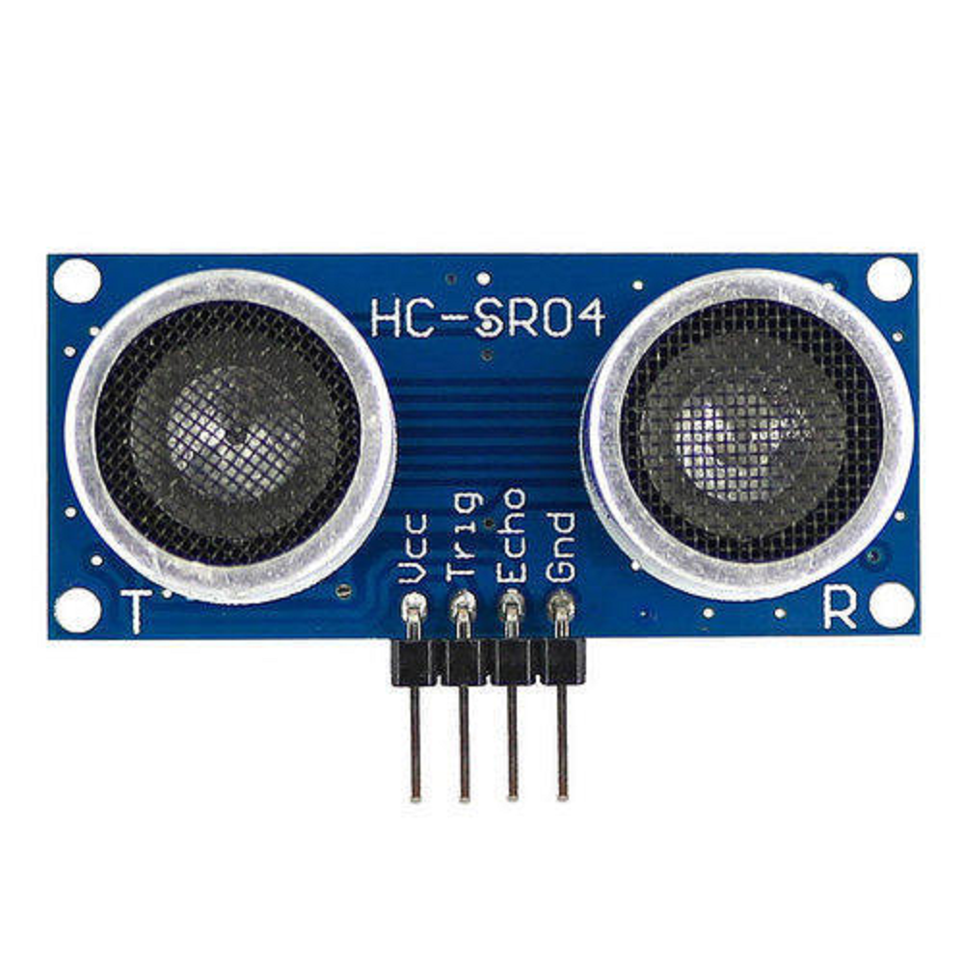
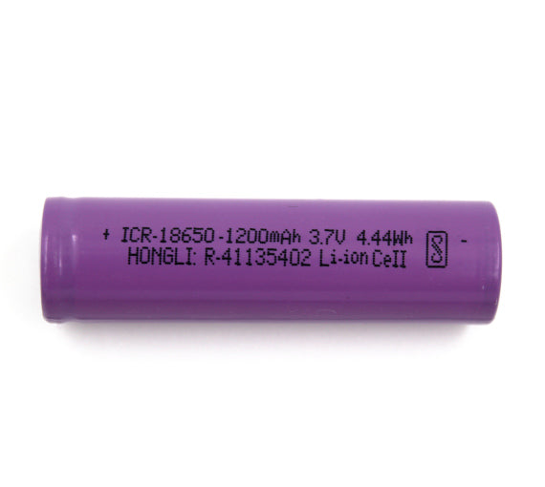
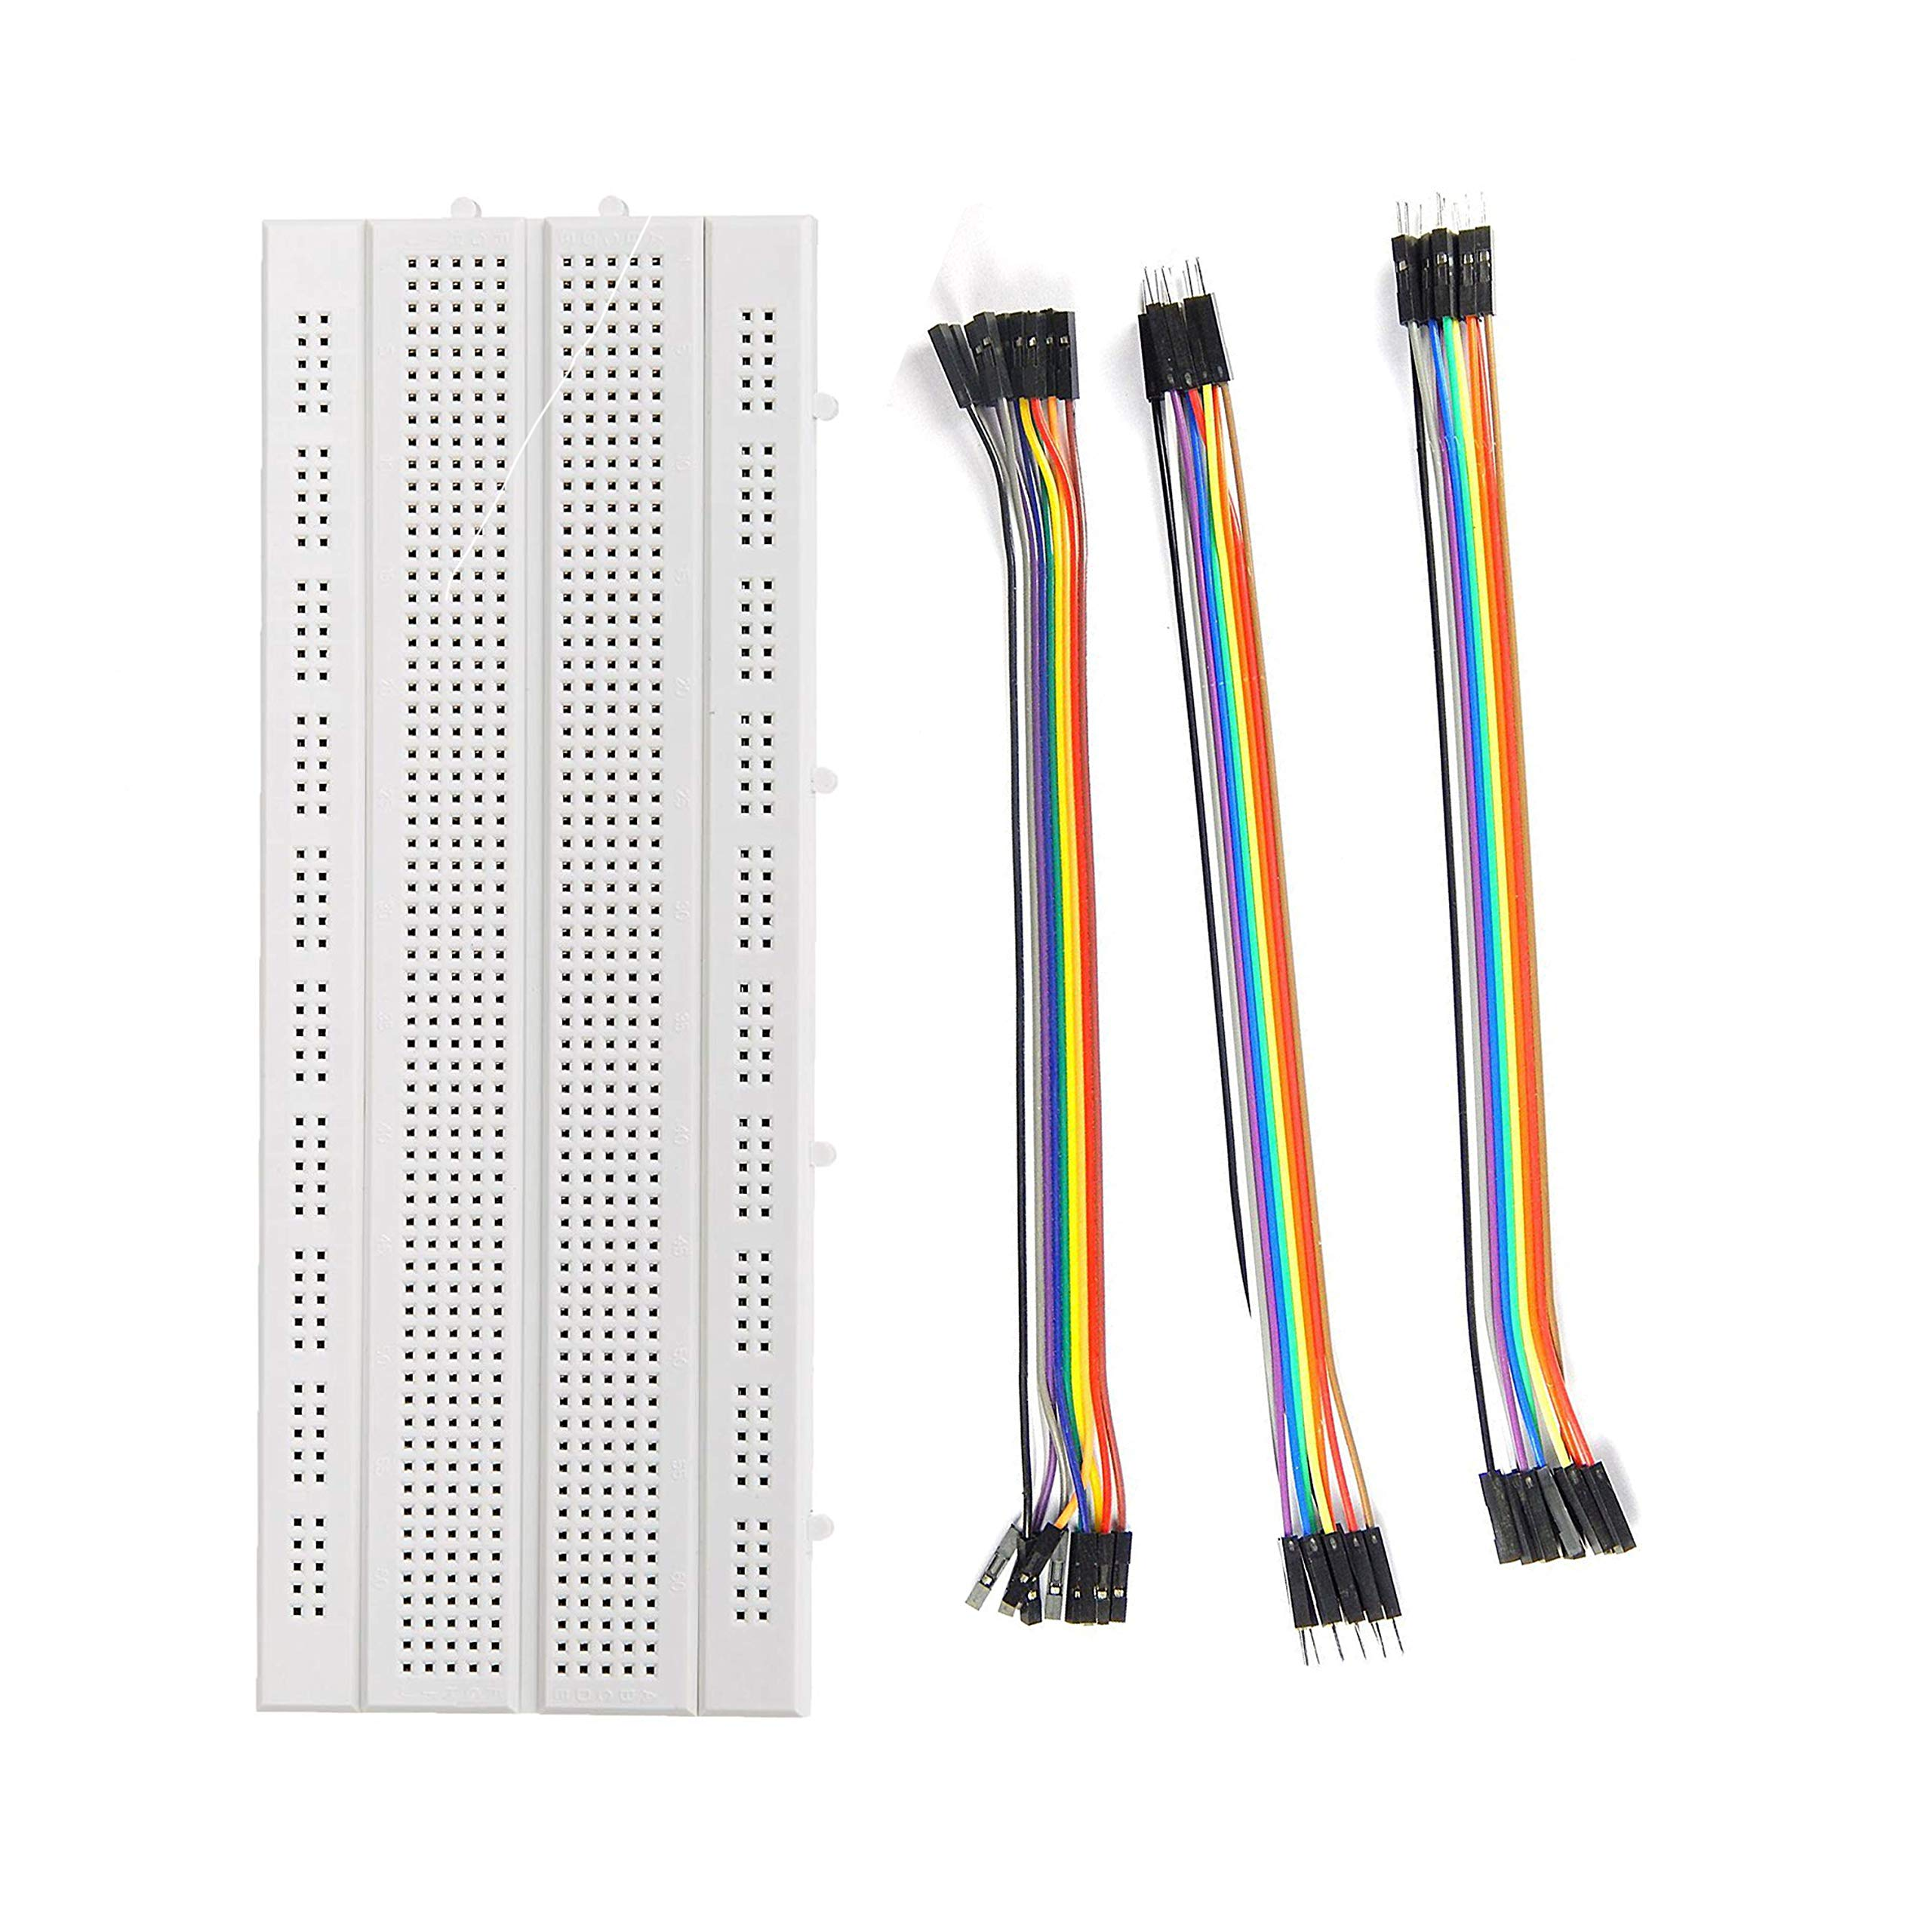
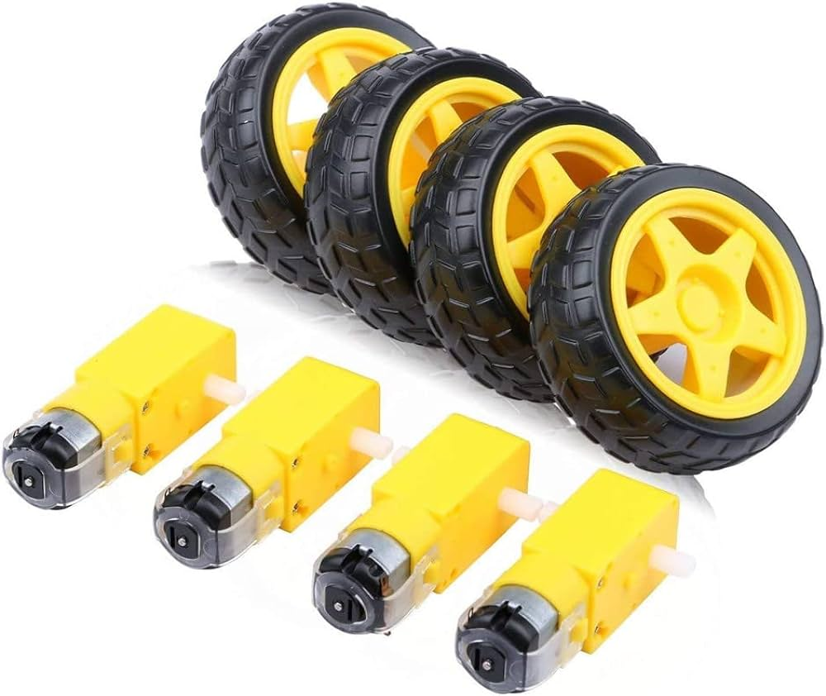
Ultrasonic Sensor HC-SR04
3.7V Li-ion Cell
Breadboard & Jumper Wires
DC Motors & Wheels

Slide 7
BLOCK DIAGRAM
MICROPHONE
VOICE MODULE
ULTRASONIC SENSOR
ARDUINO UNO
POWER SUPPLY
LEFT MOTOR
MOTOR DRIVER
RIGHT MOTOR
BATTERY

Slide 8
WORKING
Arduino Bluetooth Control Application
Upon startup, a Bluetooth request is initiated if Bluetooth is turned off.
The smartphone's microphone captures the user's voice as an audio signal. The analog audio signal is converted into a digital format by smartphone’s ADC.
Characters ‘1’, ‘2’, ‘3’, ‘4’ and ‘5’ are send to the Arduino corresponding to the “FORWARD”, “BACKWARD”, “RIGHT”, “LEFT”, and “STOP” commands.
2. Sending of data to Arduino
The HC-05 pairs with the smartphone using Bluetooth, establishing a wireless communication link.
Data sent from the smartphone is received by the HC-05, which then sends it to the Arduino.

Slide 9
3. Detection of obstacles
Ultrasonic sensor detects the presence of an obstacle within 20 cm range.
4. Sending of data to the Motor Driver
Arduino controls the motor driver according to the character being sent to it by the Bluetooth module.
Based on the signals from the motor driver, the motor operates at the desired direction, converting electrical energy into mechanical motion.
Forward motion occurs only if there is no obstacle within 20cm.

Slide 10
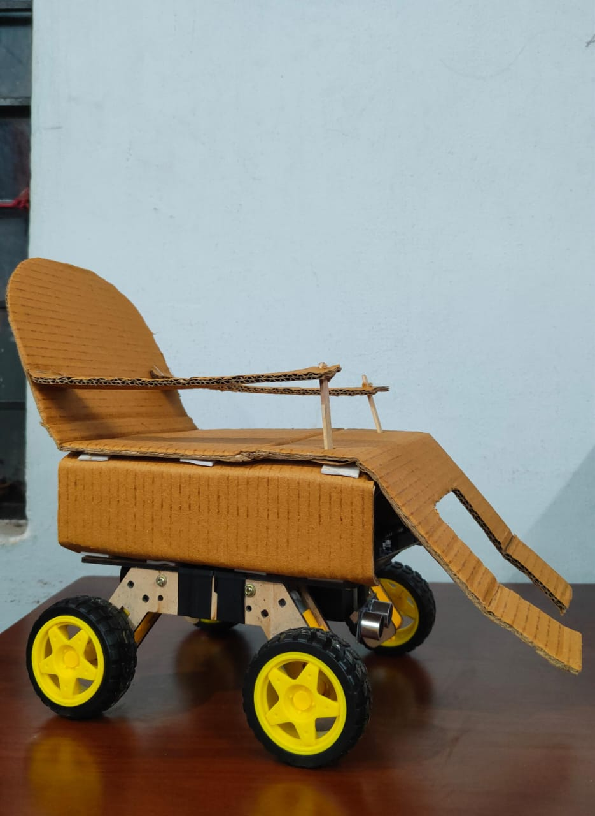
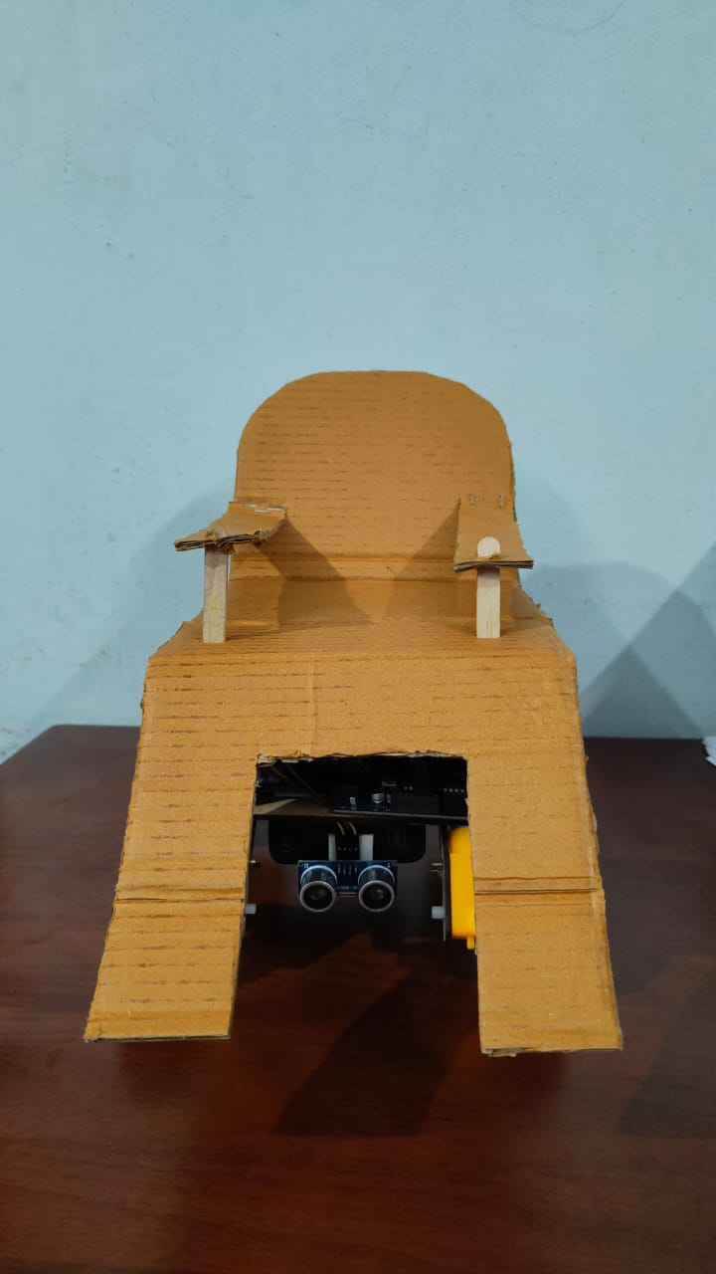
ACHIEVED RESULTS

Slide 11
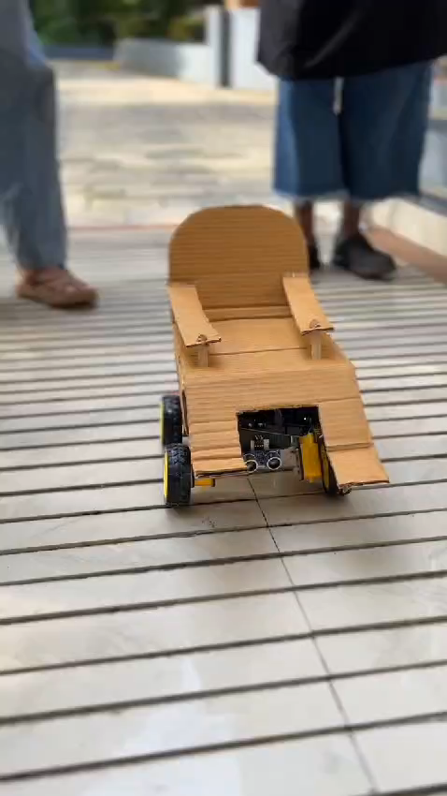

Slide 12
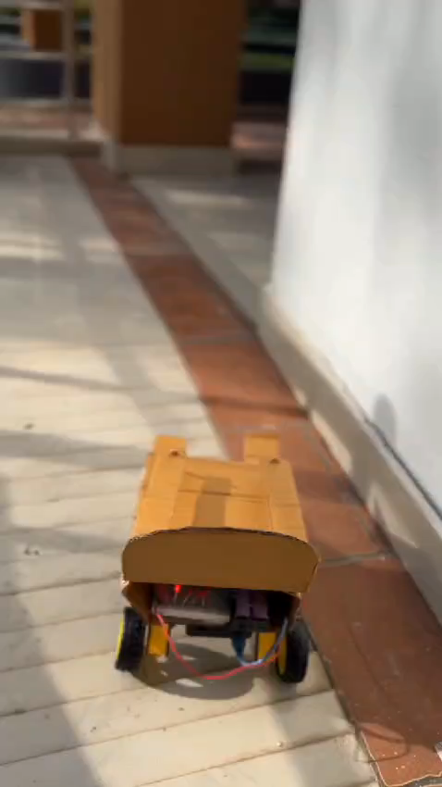

Slide 13
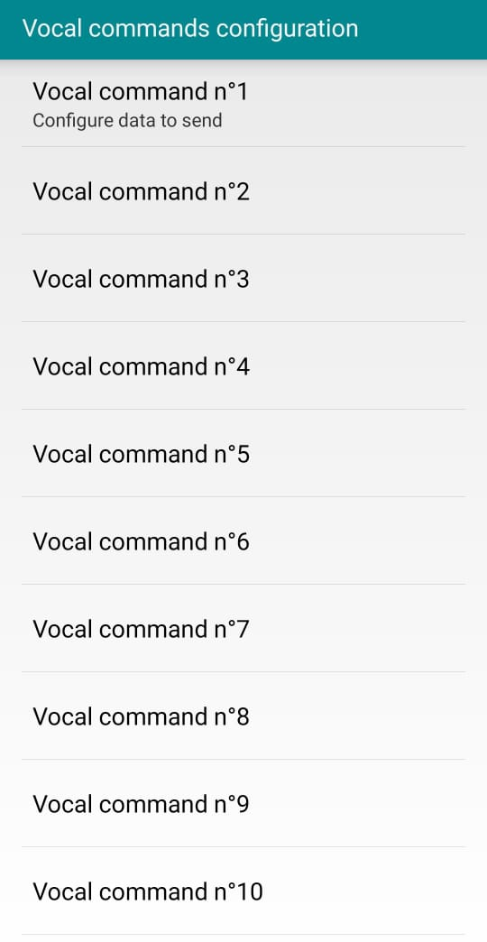
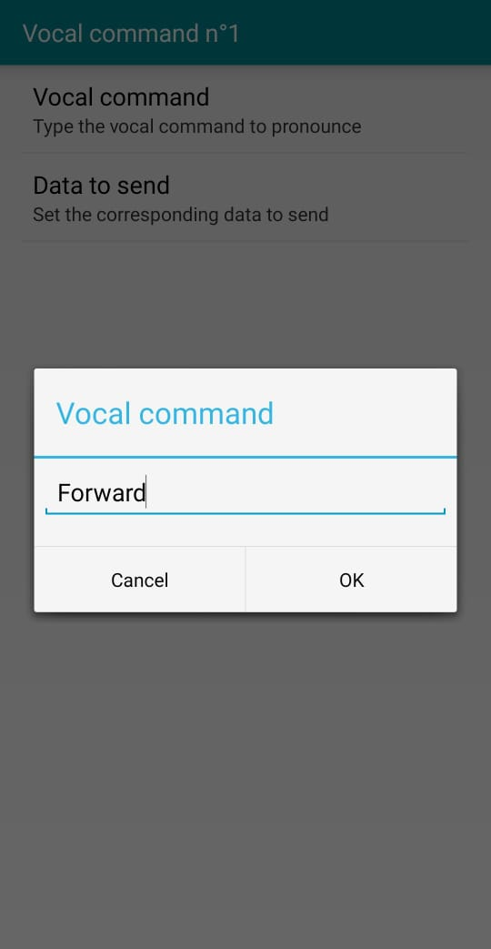
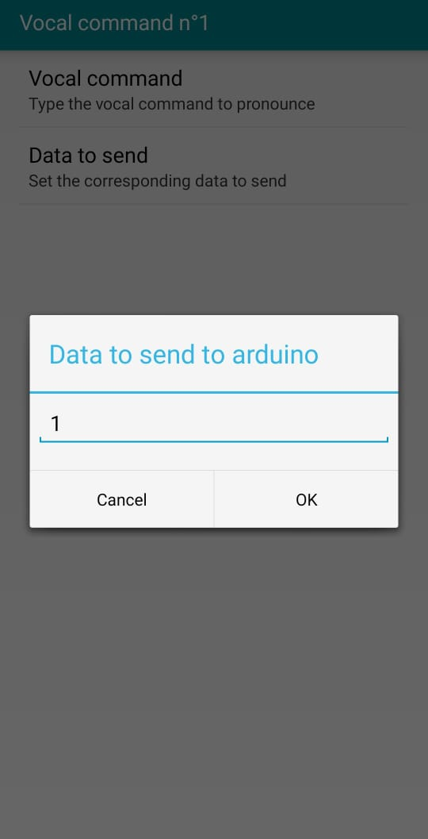
Arduino Bluetooth Control Application

Slide 14
FUTURE SCOPE
Voice control using local language
Step climbing wheelchair
Seat adjustment facility
Integration with Home Automation
Health Monitoring

Slide 15
REFERENCES
“Design and Implementation of an Electric Wheel-Chair to Economies it with Respect to Bangladesh” , Humaira Salmin, Hafiz Rakibul, Pratik Kumar Kundu, B.M. Fahmid Jahur , International Journal of Multidisciplinary Sciences and Engineering, Vol. 5, No. 2, pp: (17-22), February 2014
“Voice Controlled Motorized Wheelchair with Real Time Location Monitoring”, Nikunj Janak Gor, Amrutha Jeyakumar International Conference on Energy, Communication, Data Analytics and Soft Computing 2017
“Voice Controlled Automatic Wheelchair”, Sumet Umchid, Pitchaya Limhaprasert , The 2018 Biomedical Engineering International Conference
“Wheelchair for Physically and Mentally Disabled Persons”, Nirmal T M, International Journal of Electrical and Electronics Research, ISSN 2348-6988 (online), Vol. 2, Issue 2, pp: (112-118), April - June 2014

Slide 16
THANK YOU

